Slide 1


Bank Customer Segmentation & Transaction Analysis
Presented by Vishal Chavanke
Notes:
In simple words, I tried to understand how different types of bank customers behave, how much they contribute to revenue, and how the bank can use this information to improve decisions."

Slide 2
Presentation Overview
1
Color Palette
2
Problem Statement
3
Business Objectives
4
Methodology
5
Data Preparation
6
Key Visuals
7
Dashboard
8
Link to the Dashboard
9
Conclusion
10
Recommendations

Slide 3
Color Palette
I used mainly three colors in the dashboard to keep it simple and easy to understand
Dark Blue:
Light Blue : Female Data & Age Group Trends
Orange: New Customers & Revenue bars
Used for male customers, main charts, and background. It gives a professional and trustful banking look.
Used to show female customer data and other trends. It makes comparison easy without being too bright.
Highlights important or high-activity areas, like new customers and revenue contribution.

Slide 4




Problem Statement
Data Volume Challenge
The bank has a lot of customer and transaction data but it is not easy to understand or use for decision-making.
Revenue Pattern Gap
There is no clear insight into which age groups, genders, or locations contribute the most to total revenue.
Customer Classification Issue
The bank cannot easily identify who is a new, loyal, or inactive customer just from the raw transaction records.
Solution Objective
To analyze the dataset and create a Power BI dashboard that helps the bank understand customer segments and make data-based decisions.
Notes:
Banks have a lot of data — customer details, transactions, balance, location, and more. But this data remains stuck in Excel sheets and databases
So I want to know
• Which age group gives the most revenue? • Which city performs the best?
• Who are our best customers?

Slide 5

Business Objectives
Understand Customer Transactions: Analyze how different customers (by age, gender, and location) use banking services and make transactions.
Find Revenue-Generating Customer Segments: Identify which customer groups (new or loyal, age groups, cities) contribute the highest revenue to the bank.
Support Better Business Decisions: Provide insights that help the bank improve customer retention, marketing strategies, and growth planning.
Notes:
So my goal was simple –
Convert raw bank data into meaningful insights.
Create a dashboard using Power BI so anyone can easily understand customers .
Help the bank take smarter decisions about marketing, retention, and expansion.

Slide 6




Methodology
1. Data Collection
3. Visualization
Collected customer and transaction data including age, gender, location, account balance and transaction amount.
Designed dashboards in Power BI to show patterns based on age groups, gender, customer status, revenue, and top locations.
2. Data Cleaning & Analysis
4. Insight Extraction
Removed errors, fixed missing values (like DOB), created new columns like Age and Customer Status using Power BI and DAX.
From the visuals, identified who contributes more revenue, which locations perform best, and where the bank can improve retention or growth.

Slide 7





Data Preparation
Cleaning
Final Visualization
Data is processed to remove errors and inconsistencies.
The refined data is presented in a visual format.
Raw Data
Calculated Fields
Initial data is collected from various sources.
New fields are derived to add value and insight.
Data Cleaning
Metric Calculation
Data Grouping
Removed blank or null values, particularly incomplete entries for gender or transaction amounts, ensuring data integrity.
Created key calculated fields using Power BI DAX functions, such as Avg Transaction Value and Total Revenue.
Grouped records by segmentation variables like AgeGroup (e.g., 26-35, 36-45), Gender, and Location for targeted analysis.

Slide 8





Key Visuals
Bar Chart - Customer Gender, Age Group Distribution
Donut Chart - Male vs Female & New vs Loyal Customers
Clustered Bar Chart - Top Locations By Revenue
The 26-45 age group is the most active, with a higher proportion of transactions initiated by males.
Gender representation shows a split of 73% Male and 27% Female in the customer base.
The 36-45 age group records the highest average transaction volume, especially the male segment.
Stacked Bar Chart - Top Locations by Customer Volume
Line Chart - Revenue Trend Over Time
Revenue peaked significantly in September 2016, suggesting a strong seasonal effect or successful targeted campaigns.
The highest concentration of customers is found in metropolitan centers: Mumbai, Bangalore, and New Delhi.

Slide 9
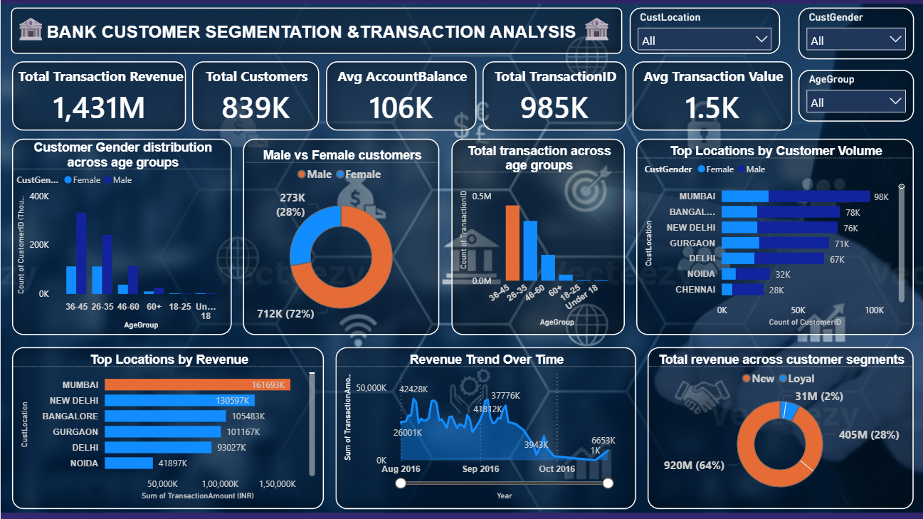
Dashboard Overview
Notes:
Top KPI Cards (Top Row)
“These key metrics give us an overview of the bank's performance

Slide 10
Link to the Dashboard
Click Here

Slide 11
Conclusion
1
2
Demographics
Gender Trend
Most customers are between 26–45 years age group. This shows that are the young working professionals who actively use banking services.
Male customers are slightly higher in number and revenue.
But female customer growth is increasing, which is a good opportunity for the bank.
3
4
Customer Loyalty
Growth Potential
93% of revenue comes from new customers, which shows strong customer acquisition.
But loyal customers contribute only 7%, meaning retention is low and customers don’t stay active for long.
Most revenue comes from big cities like Mumbai and Delhi. There is a high opportunity in Tier-2 cities and less-targeted groups, like loyal or female customers.

Slide 12




Recommendations
Strengthen Customer Retention
Expand into Tier-2 Cities
Start a customer retention program – rewards, offers, loyalty benefits.
Most customers and revenue come from metro cities like Mumbai and Delhi
Expand into Tier-2 cities to reach new markets.
Focus on Young Professionals (26–45 years)
Increase Engagement of Female Customers
Focus on young professionals (26–45) by offering digital banking, investment plans, and credit products specially for them.
The bank can design women-focused savings plans, loans, or offers to increase female participation.

Slide 13

Thank You

